Slide 1
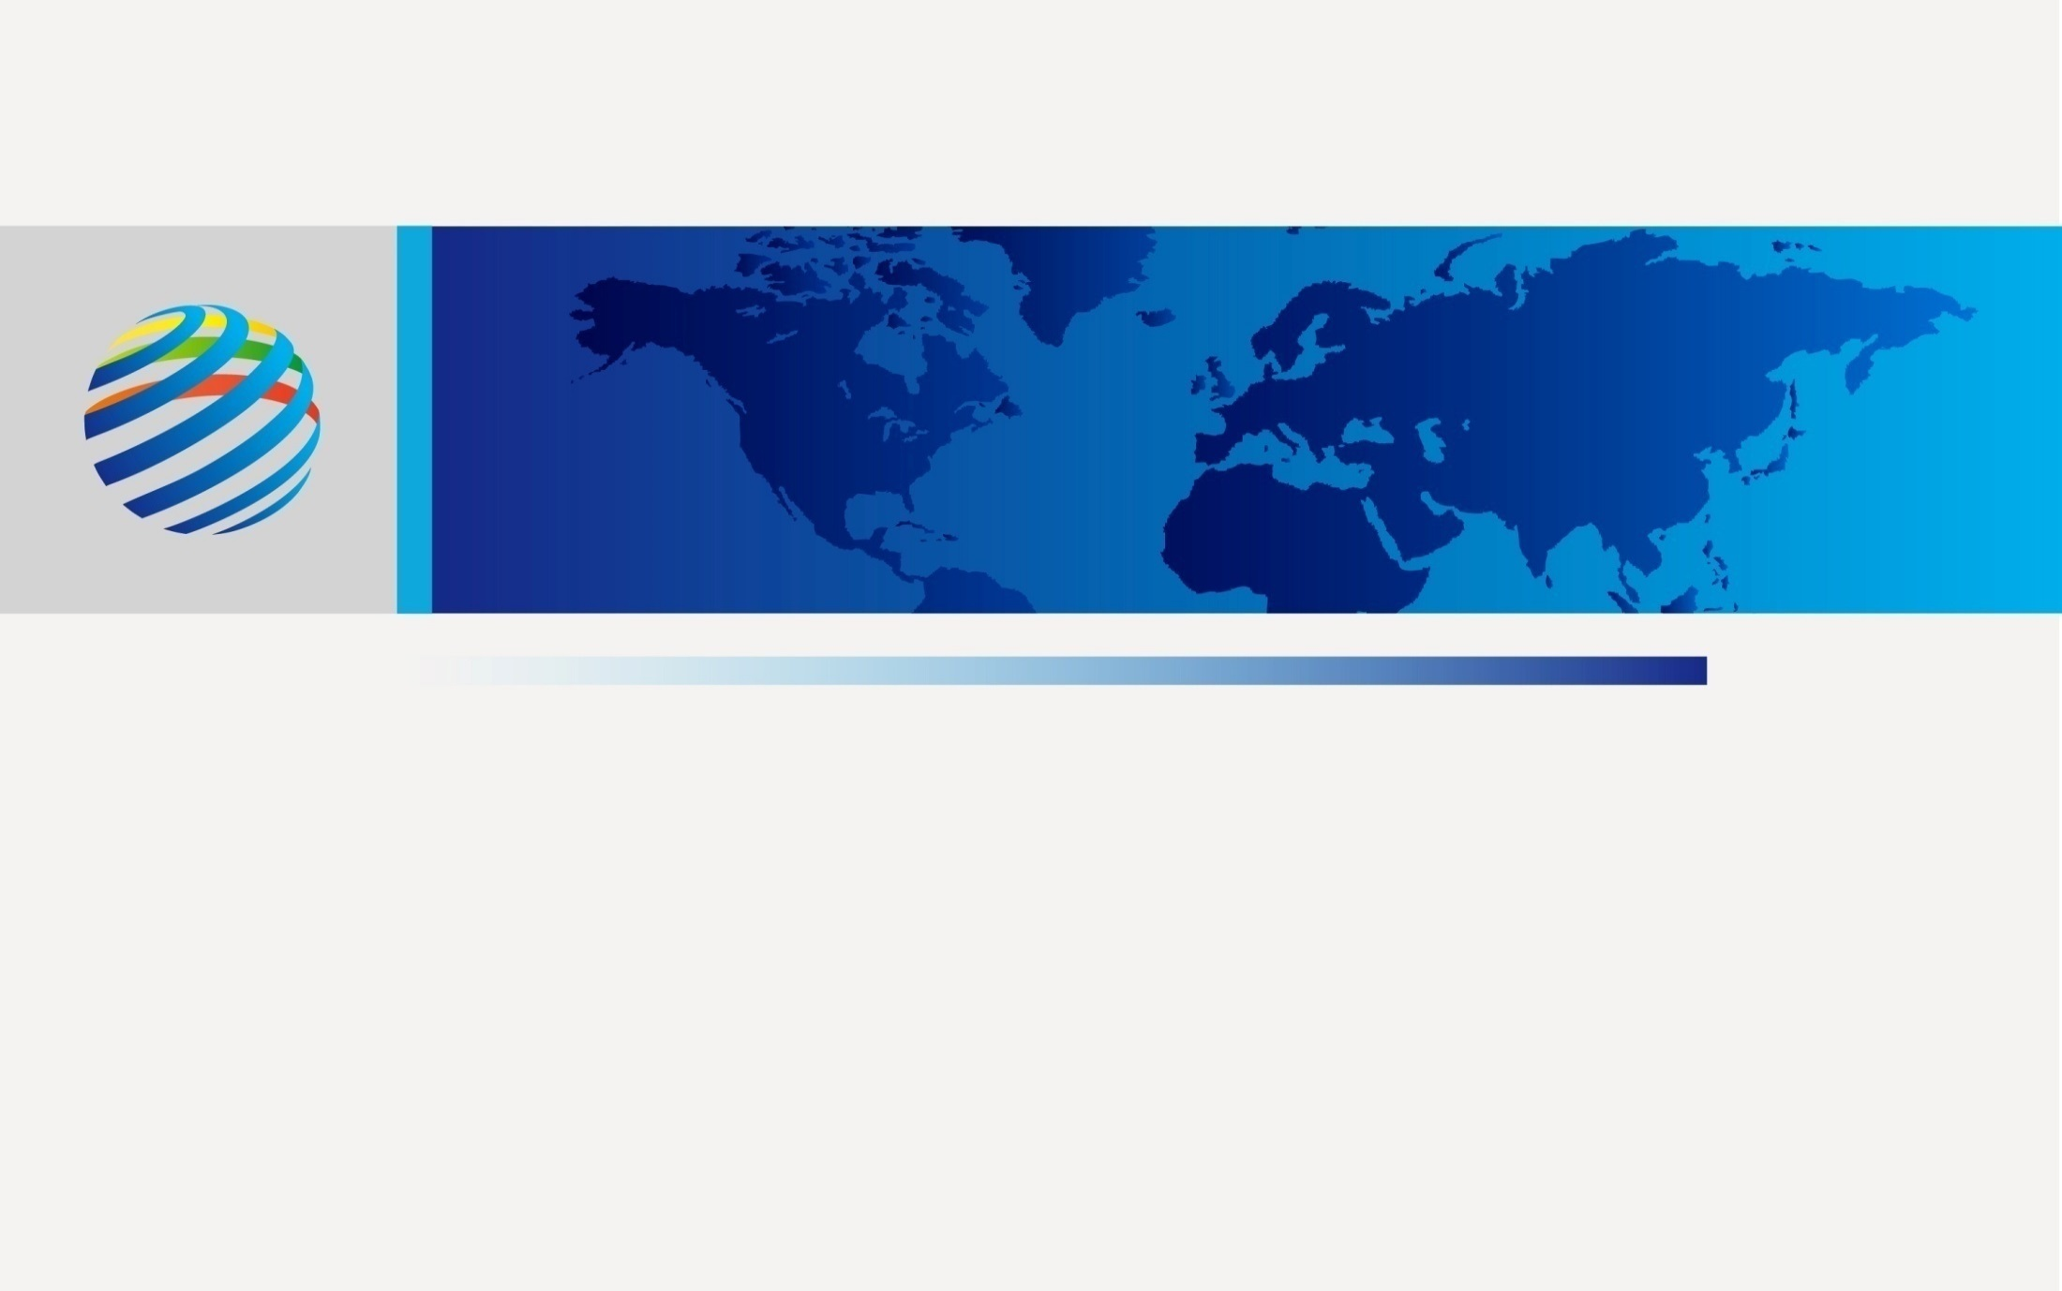

GEI Vision:Opportunitis for Renewable Energy and Interconnection of Arab States
6th Session of the Arab-China Cooperation Conference on Energy
Global Energy Interconnection Development and Cooperation Organization
November 2018

Slide 2

1. Global Energy Transition and GEI
2. Renewable Energy Development Opportunity of Arab States
3. Vision of Arab States Energy Interconnection
Notes:
2

Slide 3
(1) Coping with Challenges to Realize Sustainable Development
Chinese President Xi Jinping proposed discussions on establishing Global Energy Interconnection, or GEI, to facilitate efforts to meet global power demands with clean and green alternatives at the UN Sustainable Development Summit on Sept. 26th 2015.
GEIDCO: A fundamental path is to exploit clean and renewable energy in large scale, and to implement “two substitutions, one improvement, and one return”.
Clean substitution: in generation
Electric energy substitution: in consumption
One improvement: improving electrification level
One return: fossil fuels return to the role as industrial materials

Slide 4
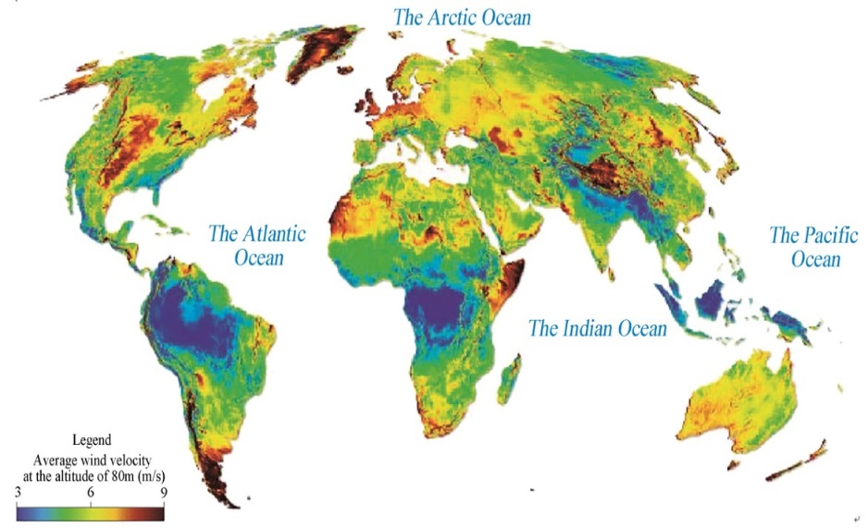
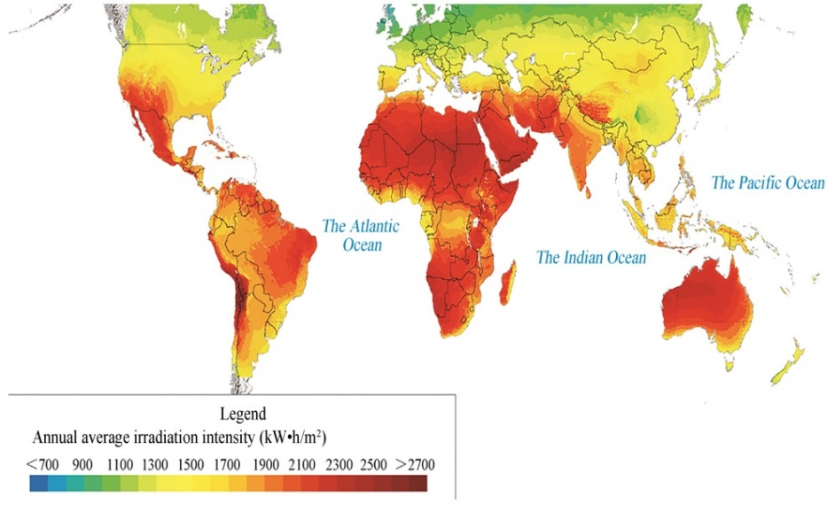
(2) Constructing GEI is a Solution for Global Energy Transition
Construting global energy interconnection (GEI) is a fundamental solution for realizing “two substitutions, one improvement, and one return”.
Global wind and solar energy: not evenly distributed, random and intermittent;
Integration into a globally interconnected power grid required for large-scale exploitation, wide-range allocation and efficient utilization of clean energy.
Distribution of Global Wind and Solar Energy Resources

Slide 5
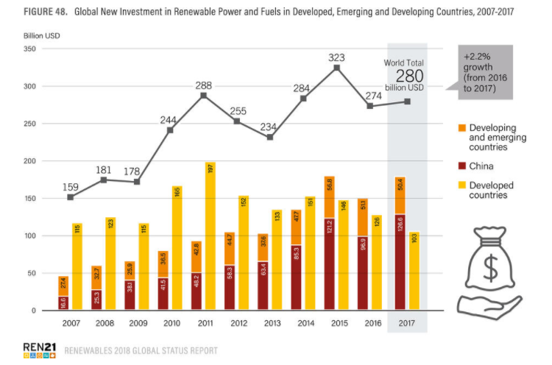
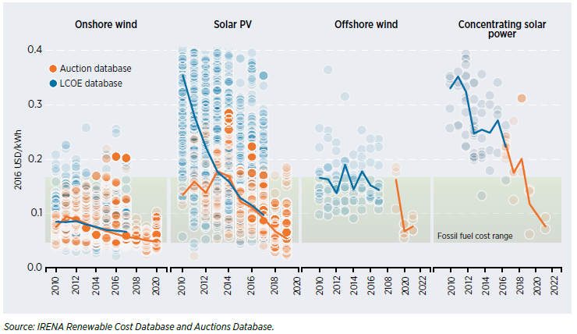
(3) Conditions for Constructing GEI are Ready
Energy transition a global consensus.
Key technologies mature.
Investment in RE continuously growing.
Costs of RE generation decreases quickly.
Growth of Global Investment in RE from 2007 to 2017
2015.9: UN 2030 SDG.
2016.11: Paris Agreement become effective.
Mature key technology: UHV transmission, smart grid, RE generation.
In 2017, RE generation investment exceeded 2/3 the total investment in power industry.
Before 2025, PV and onshore wind power be more competitive than fossil power.
In 2050, LCOE of PV, CSP, onshore and offshore wind power drop to below 2~3 cents, 6~7 cents, 4 cents and 6 cents/kWh respectively.
LCOE Trend of RE from 2010 to 2022
LCOE
Project Bid Price

Slide 6
(4) Problems and Challenges in Arab States
Economic and social development of Arab States highly dependent on oil & gas, facing challenges against sustainability.
Reducing global market space for fossil energy export of Arab states since clean energy transition has become an inevitable global trend.
Impact on the role of Arab states in global energy supply by non-conventional oil & gas exploitation in other places.
Economy not robust against risks since being dominated by oil & gas industry, and with a short industry chain.
High pressure on environmental protection and addressing climate change since domestic energy consumption dominated by oil & gas.
High pressure on fiscal balance in some Arab countries due to high energy subsidies.
Fundamental way for Arab states’ energy transition:
  large-scale exploitation of clean energy resources,
  construction of robust energy interconnection,
  and realization of multi-energy complementation.
Notes:
Large-scale exploitation of solar energy resources;
Cultivating clean energy industry chain;
Building cross-border and inter-continental energy interconnection.

Slide 7
(4) Problems and Challenges in Arab States
Facing challenges against sustainability, Arab States have developed RE strategy.
Egypt: 20% for RE in the installed capacity mix by 2022 and 42% by 2035
Algeria: 27% of electricity generated from RE by 2030
Morocco: 52% of installed electricity capacity by 2030
Tunisia: 14% of electricity production in 2020 and 30% in 2030
Jordan: 11% RE share in the total energy mix in 2015
Lebanon: 15%-20% of the power and heat demand in 2030
......
Moreover, LAS actively promotes the establishment of the Pan-Arab unified power market. GCCIA actively promotes Expansion of Grid Interconnections beyond GCC and the Development of Regional Electricity Markets.
Notes:
Large-scale exploitation of solar energy resources;
Cultivating clean energy industry chain;
Building cross-border and inter-continental energy interconnection.

Slide 8
1. Global Energy Transition and GEI
2. Renewable Energy Development Opportunity of Arab States
3. Vision of Arab States Energy Interconnection
Notes:
8

Slide 9
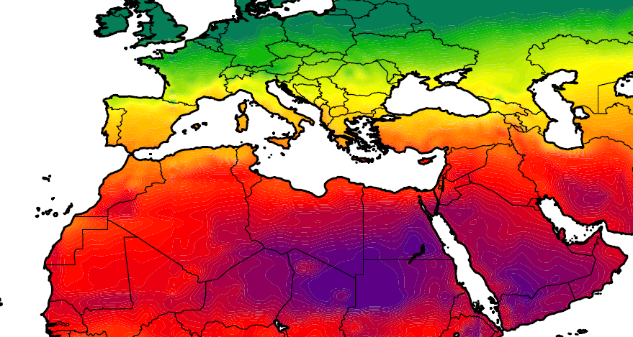
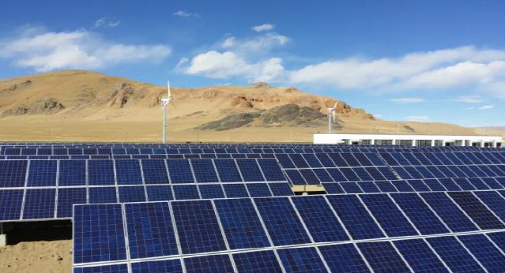
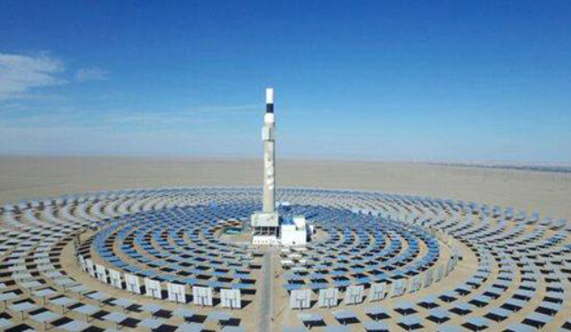
(1) An Abundance of RES in Arab States
Arab states have broad territory, indicating superior conditions and high competitiveness for the development of solar power generation.
GHI between 2,200~2,400kWh/m² in most of the region, above 2,800kWh/m² in some region.
Flat terrain suitable for centralized exploitation of large-scale solar power generation.
Bidding price for PV projects down to a minimum of 2~3 cents/kWh in KSA ; for CSP below 10 cents/kWh in UAE.
Distribution of Solar Radiation Intensity in Arab States
PV Generation
CSP Generation

Slide 10
(2) Future RE Development Opportunities
(18)
(19)
(3)
(17)
(20)
(21)
(5)
(6)
(2)
(9)
(4)
(7)
(10)
(1)
(8)
(11)
(15)
(12)
(13)
(16)
(14)
No. | Base site | TP (TWh/y) | ICP (GW)
(1) | Zag | 226.5 | 110
(2) | Zagora | 164.7 | 80
(3) | Laghouat | 514.8 | 250
(4) | Ouargla | 629.1 | 320
(5) | Remada | 100.6 | 50
(6) | Jawsh | 196.6 | 100
(7) | Minya | 359.4 | 160
(8) | Aswan | 304.2 | 130
No. | Base site | TP (TWh/y) | ICP (GW)
(9) | Tabuk(160km) | 489.6 | 110
(10) | Buraydah(140km) | 428.6 | 80
(11) | Riyadh(140km) | 533.3 | 114
(12) | Aflaj(60km) | 471.7 | 103
(13) | Umm Al Melh (145km) | 456.1 | 40
(14) | Sharurah(100km) | 456.1 | 68
(15) | Jizan(240km) | 431.1 | 40
(16) … | Obailah(270km) … | 476.8 … | 45 …
No. | Base site | ICP (GW)
(17) | Essaouira | 20
(18) | Ghazaouet | 28
(19) | Monastir | 8
(20) | Misrata | 28
(21) | Matruh | 25
*Data from GEIDCO : Africa Energy Interconnection Planning Research Report, 2018
Notes:
Based on resource endowment and exploitation conditions, the following large scale solar power bases can be developed:
North Africa: 8 bases, technical exploitable capacity: 1.2TW; 5 bases , wind plant, tec: 1.09TW
western West Asia: 10 bases, technical exploitable capacity: 2.1TW.

Slide 11
(3) Arab States as Inter-continental Energy Hub
Located at the intersection of Asia, Africa and Europe, have huge potential for acting as a strategic clean energy platform for inter-continental and inter-regional interconnection and complementation;
Supporting the realization of larger-scale and wider-area allocation and accommodation of clean energy;
Creating new opportunities for clean energy development in Arab states, Asia, Africa and Europe.
Arab States as Inter-continental Energy Hub
Europe
Asia
Arab states
Africa to the south of Sahara

Slide 12
1. Global Energy Transition and GEI
2. Renewable Energy Development Opportunity of Arab States
3. Vision of Arab States Energy Interconnection
Notes:
12

Slide 13
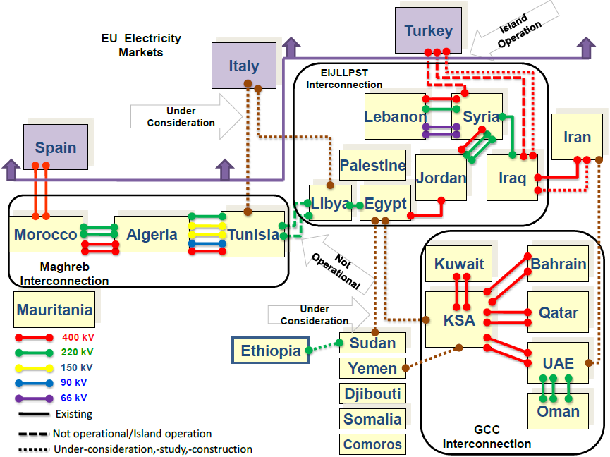
(1) Status Quo of Electricity Development
Arab States have a good power system fundation of which oil & gas dominate its generation mix and a good foundation for grid interconnection.
Generation Mix
Grid Interconnection among Arab states
Total installed capacity
250GW
*Data from the World Bank and IEA
Notes:
In 2015, total installation capacity: 250GW;
fossil generation proportion: >95%;
total power consumption: 950TWh;
power consumption per capita: 2,747kWh
maximum load: 200GW;
general rate of pop. with power access: 96%.
Existing interconnection:
Maghrib interconnection
EIJLLPST eight-country interconnection
GCCIA interconnection
Planned / Studied Interconnection:
Interconnection of Tunisia and Libya with Italy across the Mediterranean
Interconnection of Sudan with Egypt
Interconnection of Saudi Arabia with Egypt and Yemen

Slide 14
(2) Forecast of Power Demand
Based on historical data, economy development plans, etc., GEIDCO studied the future power demand of Arab states, it forecasts that:
in 2035, total power consumption: 2.5PWh, maximum load: 500GW;
in 2050, total power consumption: 3.8PWh, maximum load: 750GW.
Power Demand Prediction for Arab States
Item | Total power consumption (0.1TWh) |  |  |  |  | Total maximum load (10MW)
 | 2015 | 2035 | 2050 | 15~35 | 35~50 | 2015 | 2035 | 2050 | 15~35 | 35~50
The west of West Asia | 6852 | 18316 | 28365 | 5.04% | 2.96% | 16245 | 38515 | 57668 | 4.41% | 2.73%
North Africa | 2632 | 6415 | 9558 | 4.55% | 2.69% | 5582 | 11909 | 17348 | 3.86% | 2.54%
Arab states | 9484 | 24731 | 37923 | 4.91% | 2.89% | 21827 | 50424 | 75016 | 4.28% | 2.68%

Slide 15
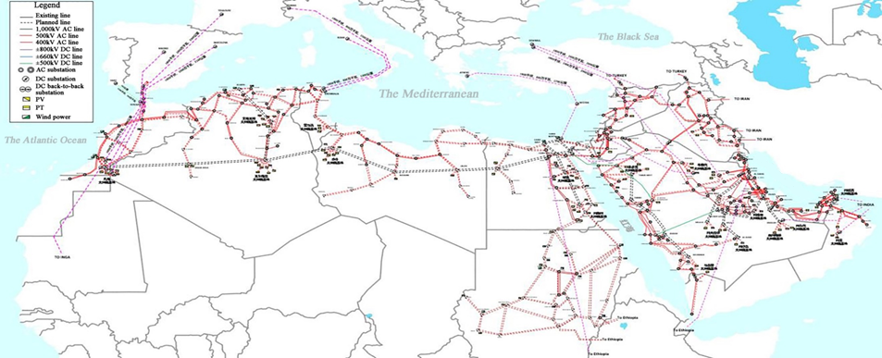
(3) Vision of Grid Interconnection
Arab states grid interconnection will be constructed on the basis of the existing grid as a inter-continental and inter-regional energy platform to promote large-scale and wide-range optimal allocation of clean energy in North Africa and West Asia, and thus promoting the clean and low-carbon energy transition.
Mid-term and Long-term Planning of Arab States Energy Interconnection
Notes:
Power grid in the western West Asia
Intra-region: KSA will interconnect surrounding countries through back-to-back DC; 400kV AC grid will be strengthened in other countries. In the long-term, voltage level can be lifted to 1,000kV by the demand of power collection and transmission of large-scale solar power bases in KSA.
Inter-region: AC interconnection will be strengthened between Jordan and Egypt; KSA will transmit solar power to Europe and South Asia through HVDC projects, and realize complementation with East Africa.
Power grid in North Africa
Intra-region: 400/500kV AC grid in North Africa will be strengthened; and the voltage level can be lifted to 1,000kV by the demand of power collection and transmission of large-scale solar power bases in North Africa.
Inter-region: asynchronous interconnection with Europe will be realized through 6 UHVDC transmission lines; 500/400kV AC interconnection with Jordan; HVDC interconnection with KSA.

Slide 16
(3) Vision of Grid Interconnection
Key Channels of Inter-continent and Inter-region Interconnection
North Africa will receive hydropower from Central and East Africa, complement with solar power in North Africa, and transmit power to Europe through the west, central and east Mediterranean channels;
Western West Asia will transmit power northward to Europe, eastward to South Asia, and realize complementation between solar energy in western West Asia and hydropower in East Africa.
Europe
North Africa
South Asia
West of West Asia
Hydropower in Central Africa
Hydropower in East Africa

Slide 17
(3) Vision of Grid Interconnection
Key Inter-continental and Inter-regional Interconnection Projects
13 key interconnection projects are proposed for inter-continental and inter-regional clean energy transmission, accommodation and complementation.
TO SOUTH ASIA
TO INGA
TO ETHIOPIA

Slide 18
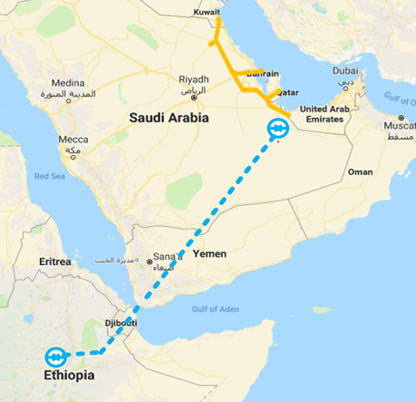
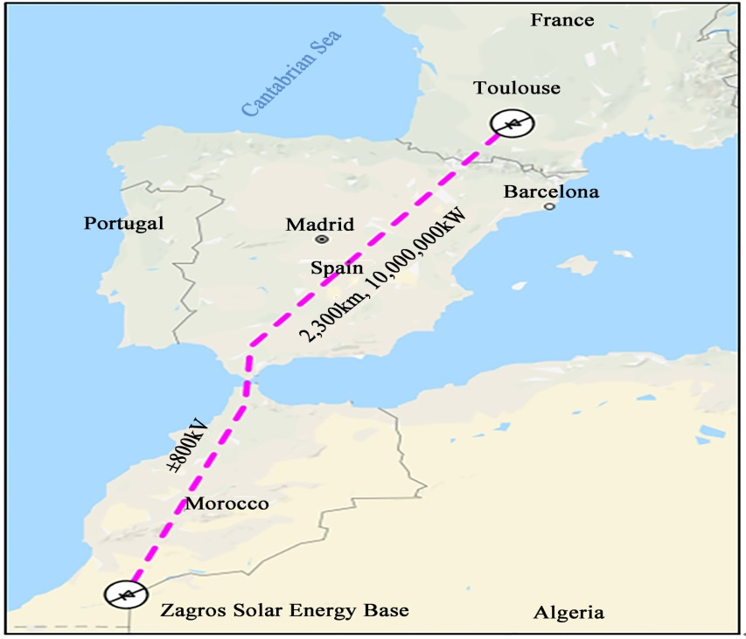
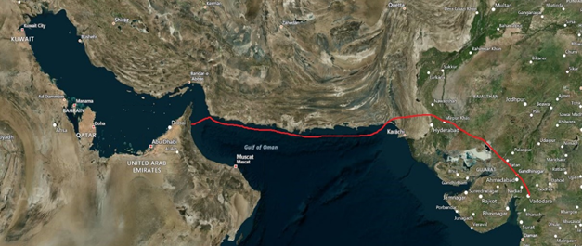
(3) Vision of Grid Interconnection
GCC Region and Ethiopia Interconnection
Morocco and France Interconnection
±660kV, 4GW, 2,000km.
Total investment: 2.4 billion USD.
±800kV, 10GW, 2,300km.
Total investment: 4.8 billion USD ..
GCC Region and South Asia Interconnection
±800kV, 8GW, 2,450km.
Total investment about 8.4 billion USD.
1,000km submarine cable
Notes:
Transmit Ethiopia hydropower to GCC region, substituting thermal generation, saving oil & gas; taking advantage of complementarity between GCC region and Ethiopia, meet the need of flexible generation in GCC region.
Clean energy exports from GCC region to South Asia, converting resource advantages to economic advantages, supporting social and economic development in South Asia.
Transmit bundled Inga hydropower and Morocco solar power to France; realize complementation between Morocco and France; improve channel utilization efficiency. Arrival cost: 1~3 cents/kWh lower than North Sea wind power in Europe.

Slide 19




(4) Benefits of Arab States Energy Interconnection
New role: accelerate energy transition, turn Arab States from an important global fossil energy supply center to clean energy supply center, and from a participant to a leader in handling climate change.
New motivation: promote development of clean energy industry chain of Arab states, change the driving force of economic development from oil & gas industry to clean energy.
New platform: expand cross-border and inter-continental energy and economic cooperation, construct new cooperation platform in Arabian region, and promote regional peaceful and stable development.
Reduction of CO₂ emission
Reduction of fuel consumption
Saving energy subsidy
2035
207
*billion USD
2035
2035
2050
1.4
470
279
*billion USD
bllion tons/yr
million tons/yr
Foreign exchange earnings from electricity export
2050
2050
2.6
850
2035
9
bllion tons/yr
million tons/yr
*billion USD
2050
24
*billion USD

Slide 20

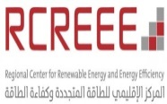
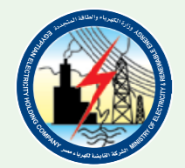


GEIDCO Cooperates with the Arab States
Partners |  | Contents | Signing Time
League of Arab States (LAS) |  | Host global energy interconnection training session in Cairo, in October 2018. | 2018
Regional Center of Energy and Energy Efficiency (RCREEE) |  | Cooperation on low carbon transformation, renewable energy development and energy interconnection to advance strategy research | 2018
Gulf Coordination Council Interconnection Authority (GCCIA) |  | Jointly research for the development of interconnected grid and renewable energy projects | 2017
Ministry of Electricity and Renewable Energy Arab Republic of Egypt |  | Jointly promote the interconnection of power grid in Egypt and its neighboring countries | 2017
The Egyptian Electricity Holding Company (EEHC) |  | membership | 2018
Cairo University(CU) |  | membership | 2018
National Engineering School of Tunis (ENIT) |  | membership | 2018
Notes:
Transmit Ethiopia hydropower to GCC region, substituting thermal generation, saving oil & gas; taking advantage of complementarity between GCC region and Ethiopia, meet the need of flexible generation in GCC region.
Clean energy exports from GCC region to South Asia, converting resource advantages to economic advantages, supporting social and economic development in South Asia.
Transmit bundled Inga hydropower and Morocco solar power to France; realize complementation between Morocco and France; improve channel utilization efficiency. Arrival cost: 1~3 cents/kWh lower than North Sea wind power in Europe.

Slide 21





GEIDCO Cooperates with the Arab States
Partners |  | Contents | Signing Time
Pan-Mediterranean Energy Co. (Jordan) |  | membership | 2018
DII-DESERT ENERGY |  | membership | 2018
Al Gihaz Company |  | membership | 2018
Society of Electrical Engineers |  | membership | 2018
AM Consultancy |  | membership | 2018
Tunisia Society of Engineers |  | membership | 2018
… |  | … | …
Notes:
Transmit Ethiopia hydropower to GCC region, substituting thermal generation, saving oil & gas; taking advantage of complementarity between GCC region and Ethiopia, meet the need of flexible generation in GCC region.
Clean energy exports from GCC region to South Asia, converting resource advantages to economic advantages, supporting social and economic development in South Asia.
Transmit bundled Inga hydropower and Morocco solar power to France; realize complementation between Morocco and France; improve channel utilization efficiency. Arrival cost: 1~3 cents/kWh lower than North Sea wind power in Europe.

Slide 22
Take Actions to Accelerate Construction of Arab States Energy Interconnection
Reaching consensus and innovate concept to jointly promote construction of Arab States Energy Interconnection.
Accelerate developing solar power bases: make full use of clean energy resources and geographical advantages, preferentially exploit large-scale solar power bases.
Accelerate constructing cross-border and inter-continental grid Interconnection: make full use of geographical advantages to jointly construct cross-border and inter-continental grid interconnection, and realize the supporting platform for cross-time and space collaborative development and wide-area allocation of clean energy.
Innovate cooperation mechanism and business models: determine prioritized clean energy generation and grid interconnection projects; actively innovate electricity market trading mechanisms, multi-lateral/bi-lateral cooperation mechanisms and cross-border projects financing models, and to promote project implementation ASAP.

Slide 23
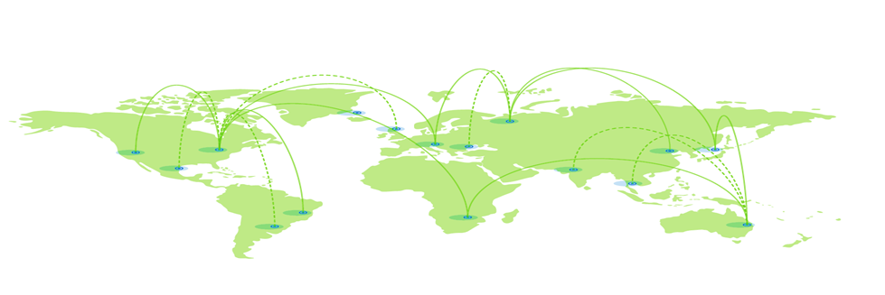
Thank You!
Notes:
11/5/2018
23

